Slide 1

Healthcare Analytics for Doctor Visits
[Jangili Pavan Kalyan]

Slide 2

PROBLEM STATEMENT:
The Healthcare Analytics for Doctor Visits project aims to analyze doctor visit data to understand patient visit patterns, appointment trends, doctor workload, waiting times, and common medical conditions.
Healthcare organizations generate a large amount of data related to doctor visits, patient appointments, diseases, treatments, and waiting times.
The analysis can help identify peak visiting hours, frequently visited departments, patient demographics, and factors affecting appointment attendance.

Slide 3
The main objective of this project is to analyze doctor visit data and identify important patterns such as the number of patient visits, frequently visited doctors or departments, patient demographics, appointment trends, waiting times, and missed or cancelled appointments. The project also focuses on identifying peak days and time periods when the number of patient visits is high
Healthcare Analytics for Doctor Visits is a data analytics project designed to analyze patient appointment and doctor visit data to understand healthcare service patterns and improve operational efficiency. Healthcare organizations handle a large volume of information related to patients, doctors, appointments, medical conditions, visit dates, waiting times, and appointment status. Analyzing this information can help healthcare providers identify trends and make better data-driven decisions.
PROJECT DESCRIPTION:

Slide 4

WHO ARE THE END USERS?
For a Healthcare Analytics for Doctor Visits project, the main end users are:
Hospital Administrators – Monitor patient visits, doctor workload, appointment trends, and hospital performance.
Doctors – Understand patient visit patterns, workload, and appointment schedules.
Hospital Management – Use analytics to plan resources, staff, and facilities based on patient demand.
Reception/Appointment Staff – Track appointments, cancellations, no-shows, and peak visiting hours.
Healthcare Department Managers – Compare department-wise visits and identify areas requiring additional resources.
Data Analysts – Analyze healthcare data and generate reports and dashboards for decision-making.
Patients (Indirect Users) – Benefit from reduced waiting times, improved appointment management, and better healthcare services.
Primary end users: Hospital administrators, doctors, hospital management, and healthcare department managers.

Slide 5

Technology Used:
Excel
Python
Pandas
Numpy
Matplotlib
Jupyter Notebook / VS Code

Slide 6
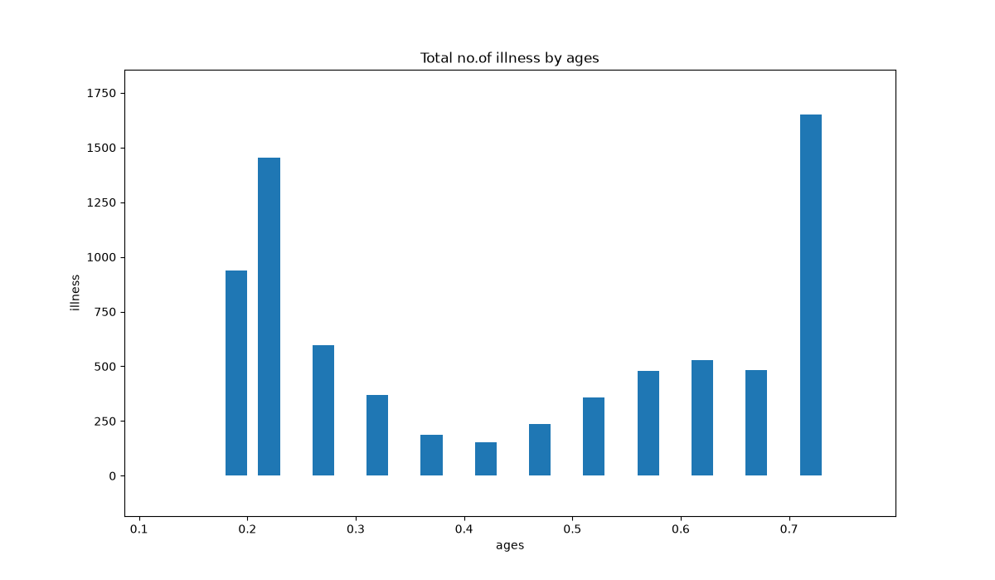
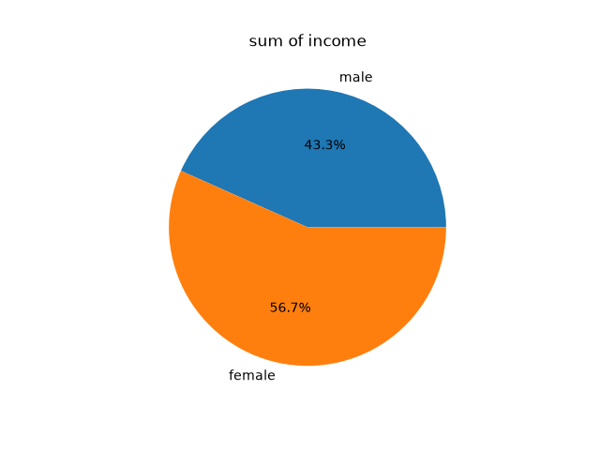
RESULTS:
x y
0 male 978
1 female 588
Patient Ages: [0.19 0.22 0.27 0.32
0.37 0.42 0.47 0.52 0.57 0.62 0.67 0.72]
Average Age: 0.4466666666666667
Minimum Age: 0.19
Maximum Age: 0.72
Total Age: 5.36
Standard Deviation: 0.1700163390840879

Slide 7
Thank you
.

